Slide 1

LINKED DATA FOR THE documenting HISTORIAN
Albert Meroño Peñuela et al.
Documenting History Workshop
Loughborough University
05-09-2016

Slide 2
So why am I here?
Albert Meroño Peñuela
Postdoctoral researcher at Vrije Universiteit Amsterdam
Web enthusiast
Love mixing data
Excited about teaching computer science
Enjoy applying its principles
Especially to other fields (Humanities, History)
Usually talk about the Semantic Web
Today
Convince you about its mission
Make something useful (and fun!) with it
2

Slide 3
agenda
Lecture (60m): Linked Data for the Documenting Historian
What is Linked Data and what problems does it solve
What does it buy you
The (CEDAR & CLARIAH) tools to make it easier
Practical session (90m): DIY on your datasets
Represent your data using Linked Data standards
Link it to other interesting datasets and concepts
Query it all combined
3

Slide 4
http://linkeddatabook.com/editions/1.0/

Slide 5
http://www.albertmeronyo.org/

Slide 6
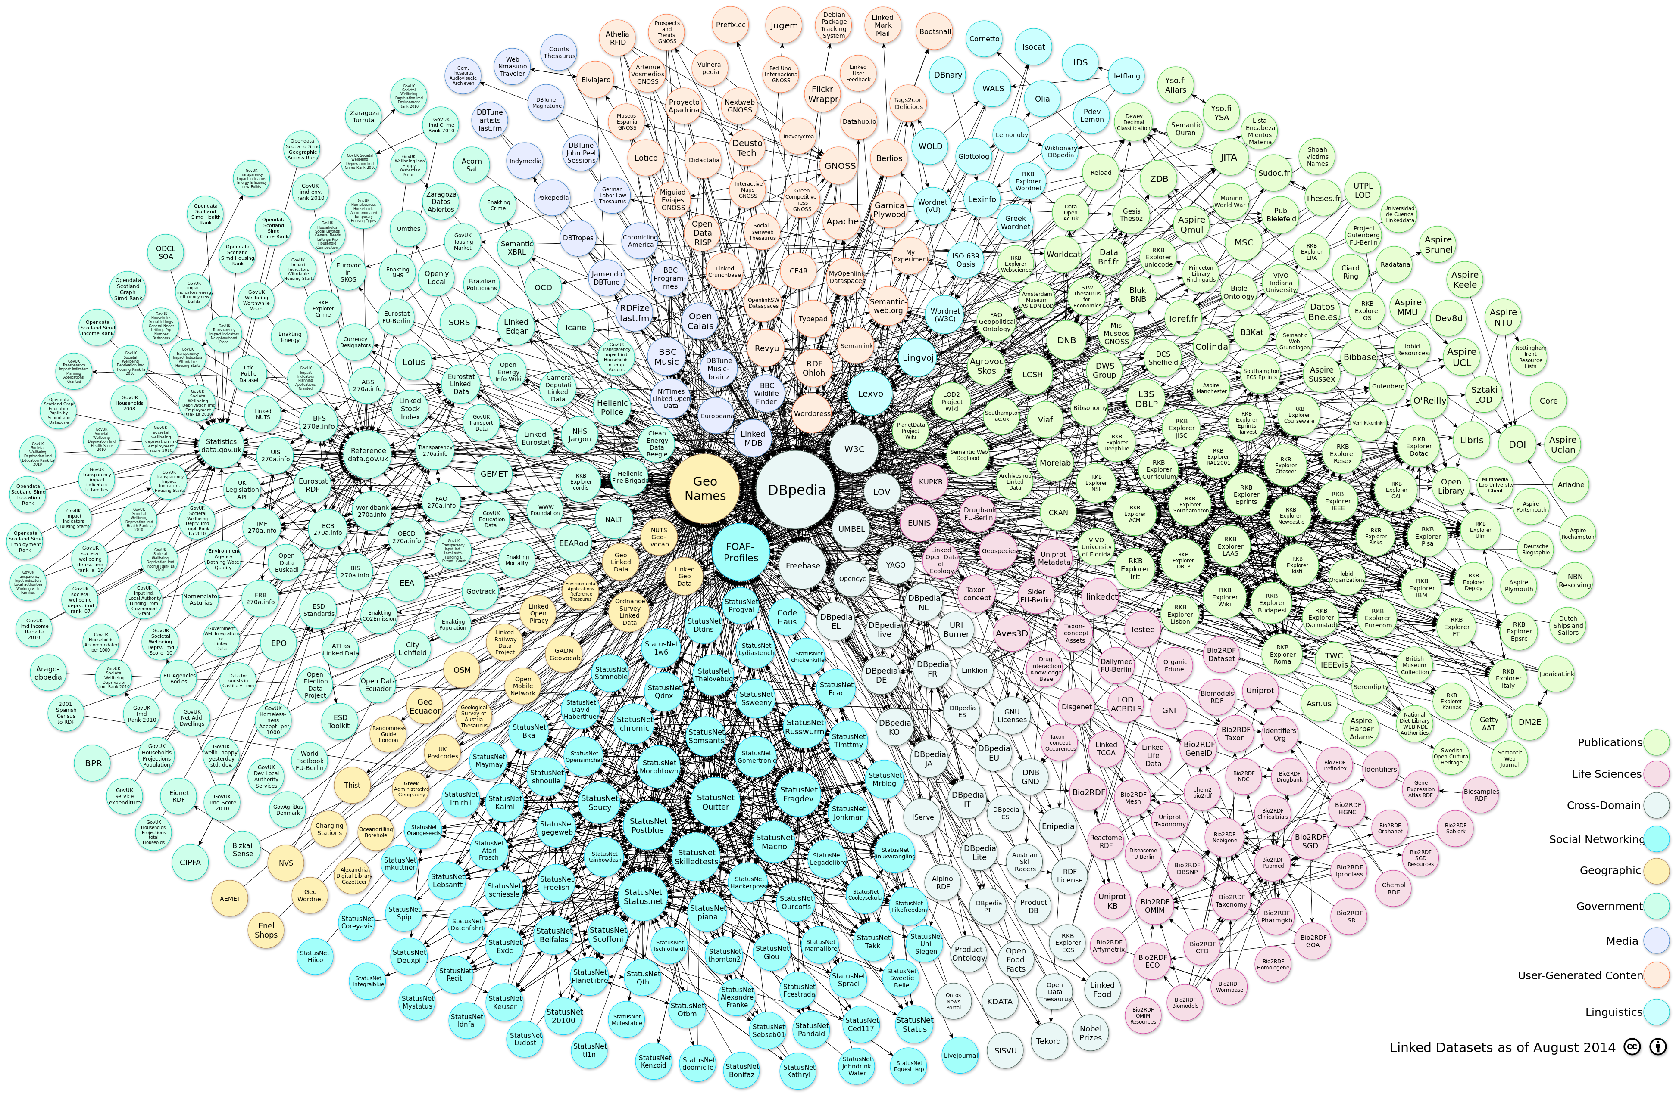
Linked data
Why bother?
6

Slide 7
See linkeddata-documentingHistory.pdf

Slide 8
Applications of linked data
To historical research
8

Slide 9
http://www.semantic-web-journal.net/content/semantic-technologies-historical-research-survey-0

Slide 10
SEMANTIC TECHNOLOGIES FOR HISTORICAL RESEARCH
Historical ontologies
Models, vocabularies & terminology to describe historical entities, processes, and events
Focus on time, persons, and geography (GIS)
SEM, EO, LODE
Text and library metadata: TEI, Dublin Core, FRBR
Historical taxonomies, code lists, classification systems
Historical occupations: HISCO, IPUMS, NAPP
Historical figures: DBpedia
10

Slide 11
SEMANTIC TECHNOLOGIES FOR HISTORICAL RESEARCH
Linking Historical Data
Circulation of scientific knowledge in Letters in the 17th century
Dutch ships and sailors
LINKS: linking individuals of historical families across databases
WW I & II naval and casualty registries
Museum collections & historical contexts
Newspapers, parlament debates
Historical census data
Text processing and mining
Search and retrieval
11

Slide 12
How is this useful?
Task speed up
Your data is better described
Your data is better findable
Provenance
12

Slide 13
Task speed up
Some tasks, especially in historical datasets, are tedious and slow
Tight and static models
Some won’t fit your data
Yours won’t fit others data
Variable coding (example later)
Somebody has done it before
Reuse ontologies and code lists
It’s flexible (Frankestein ontologies)
Saves work
Gives attribution!
13

Slide 14
Better described & findable
Accurate & generic predicates already available
http://lov.okfn.org/dataset/lov/
Links to the same entity described in other corners of the Web
Others can reach your data traversing links in other datasets!
14

Slide 15
provenance
https://www.w3.org/TR/prov-primer/
15

Slide 16
Tools tools tools
Tools tools tools tools
16

Slide 17
Tools for Linked data
Tasks with a high expertise threshold
Creating Linked Data
From scratch: various syntaxes / serialization formats (RDF/XML, Turtle, N3, Nquads)
From existing databases: need to map SQL, XML, CSV, XLS to RDF
Publishing Linked Data
Setting up triplestores to expose RDF data
De-referenceability, content negotiation: web servers
Document formatting: rendering RDF for human consumption
Accessing Linked Data
Discovering sources of Linked Data
SPARQL (query language) is not trivial!
Tools to the rescue!
17

Slide 19
Creating linked data
19

Slide 20
Creating linked data
20

Slide 21
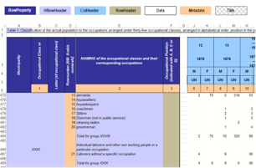

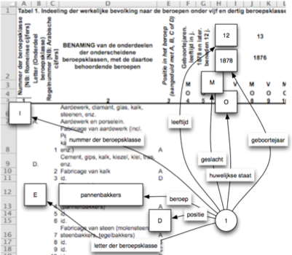
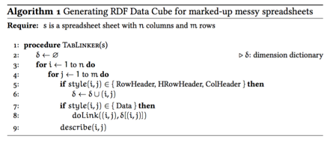
Creating linked data
https://github.com/Data2Semantics/TabLinker
21

Slide 22
Creating linked data
22

Slide 23
Creating linked data
23

Slide 24
Creating linked data
24

Slide 25
Publishing linked data
Sesame
25

Slide 26
Publishing linked data
26

Slide 27
Publishing linked data
27

Slide 28
Accessing linked data
28

Slide 29
Accessing linked data
29

Slide 30
Accessing linked data
30

Slide 31
conclusions
Linked Data: a paradigm for converting the Web into a data space
In RDF, statements in the form of subject-predicate-object link together entities represented by URIs in a giant graph of global information
History has a primary role in supplying and consuming core ontologies and datasets
Your research may become easier, faster, better discoverable and more reproducible if you publish your data as Linked Data
Tools will help you in your way
In the practical session we’ll cover (1) converting, (2) publishing and (3) accessing Linked Data

Slide 32
Questions, suggestions, comments most welcome
@albertmeronyo
http://www.datalegend.net
http://www.albertmeronyo.org

Slide 33

Text/Image slide
Use this slide to place an image to the left and text to the right.
With bullet
Secundary list
To replace the image, right-click the image (click on it with your other mouse button), select Change picture… and choose the new image.
33
Faculty / department / title presentation

Slide 34
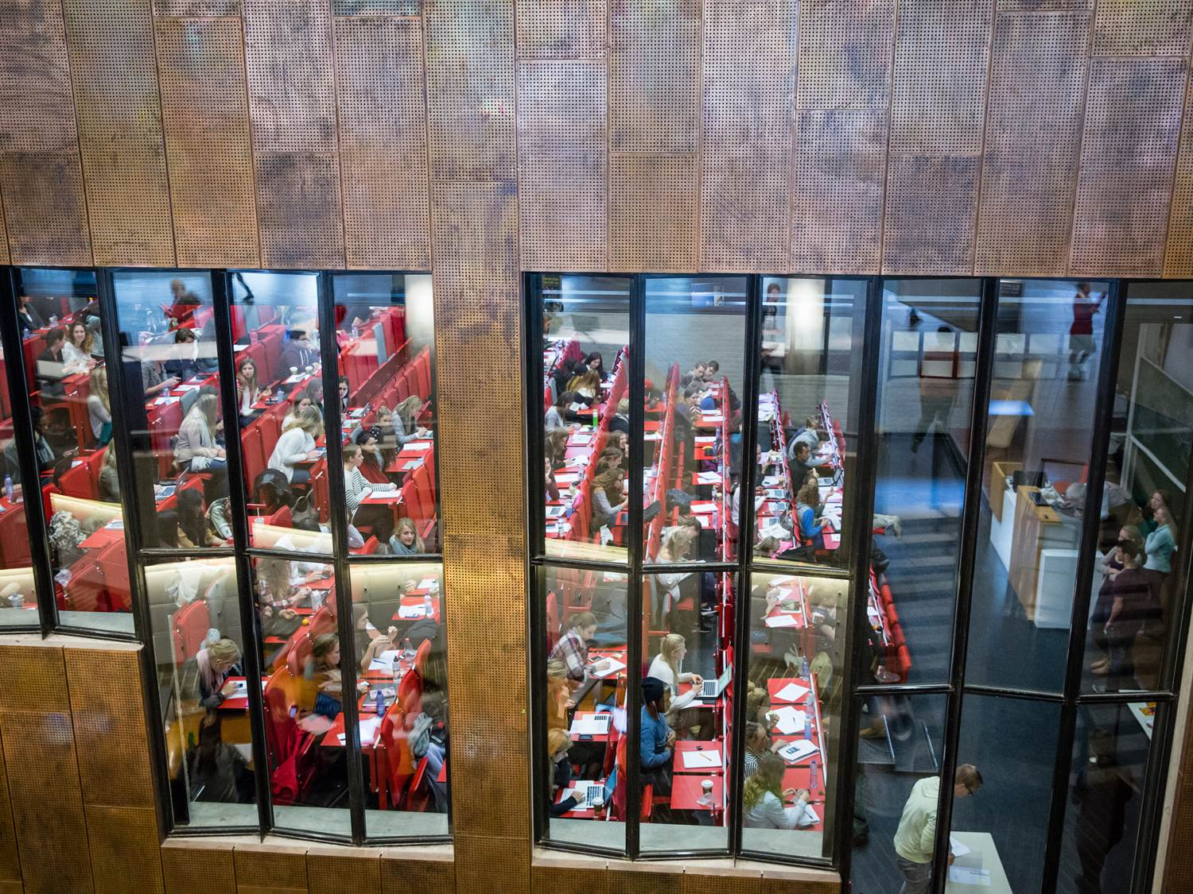
ENglish sUBtitle slide max two lines
Duplicate this slide if you want to use this layout more often during the presentation. The image can be changed.
34

Slide 35


EN subtitle slide
FEW max 2 lines
Duplicate this slide if you want to use this layout more often during the presentation. The image can be changed.
35

Slide 36

EN subtitle fEW/ FALW Max 2 lines
Duplicate this slide if you want to use this layout more often during the presentation. The image can be changed.
36

Slide 37

EN subtitle slide
FALW max 2 lines
Duplicate this slide if you want to use this layout more often during the presentation. The image can be changed.
37

Slide 38
Use this slide with black background for placing a video or image.
Remove this text box.

Slide 39
Use this slide with white background for placing an image.
Remove this text box.

